Slide 1


The first school for fishing in Greece
Lefteris Arapakis
Co-Founder & Director
Notes:
english logo

Slide 2
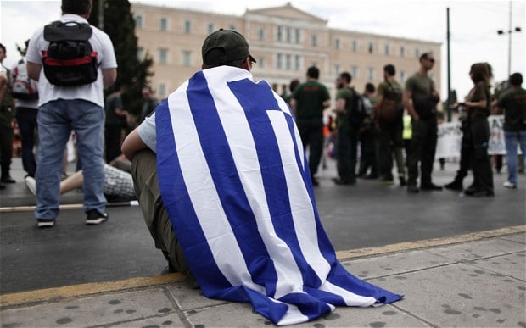
1.141.000 unemployed in Greece
( ΕΛΣΤΑΤ, February 2017)
Notes:
μηπως γενικη?

Slide 3
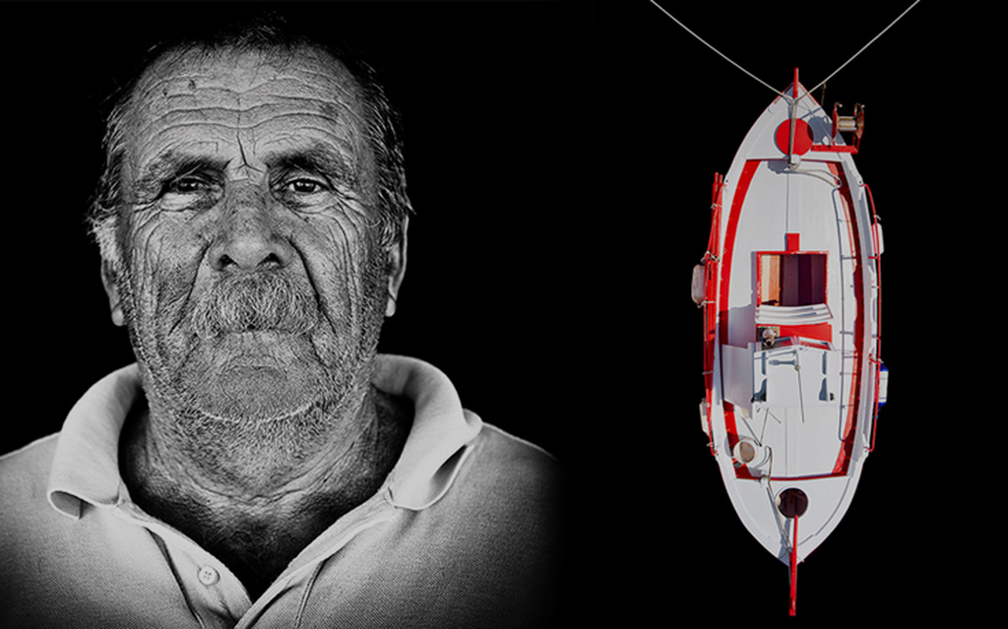
Aged Fishermen
6.000 in Greece ( ΕΛΣΤΑΤ, 2014)

Slide 4
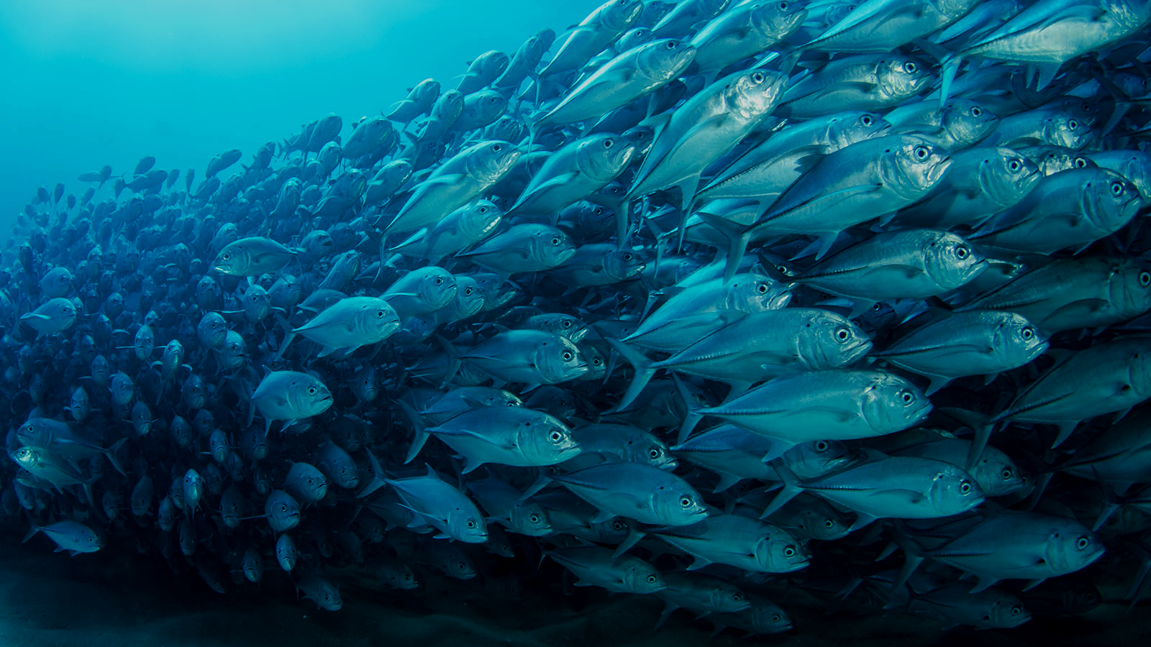

Need for Sustainable Fishing
Fish Stocks are 7.0 % less than 10 years earlier and approximately one third lower than in 1995. ( Eurostat)
Notes:
άλλη εικονα + νούμερα/ καταστροφή-> βελτιωση->ενισχυση

Slide 5


Our Vision
To unlock the human capacity in the fishing sector

Slide 6
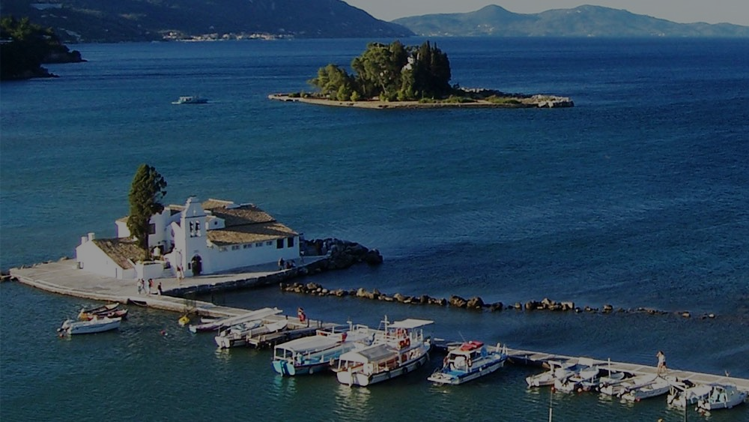
Our Mission
Sustainable Fishing Training

Slide 7
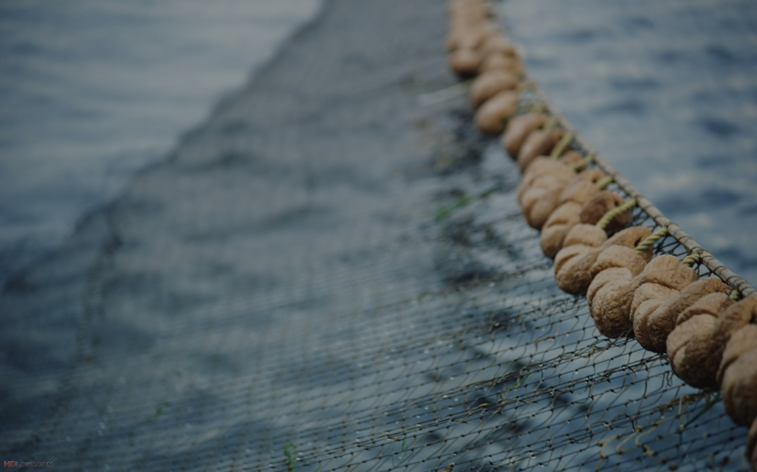
5 Μonths
Education
500 euros
Recruitment
500 euros
Enaleia
Sponsors

Slide 8
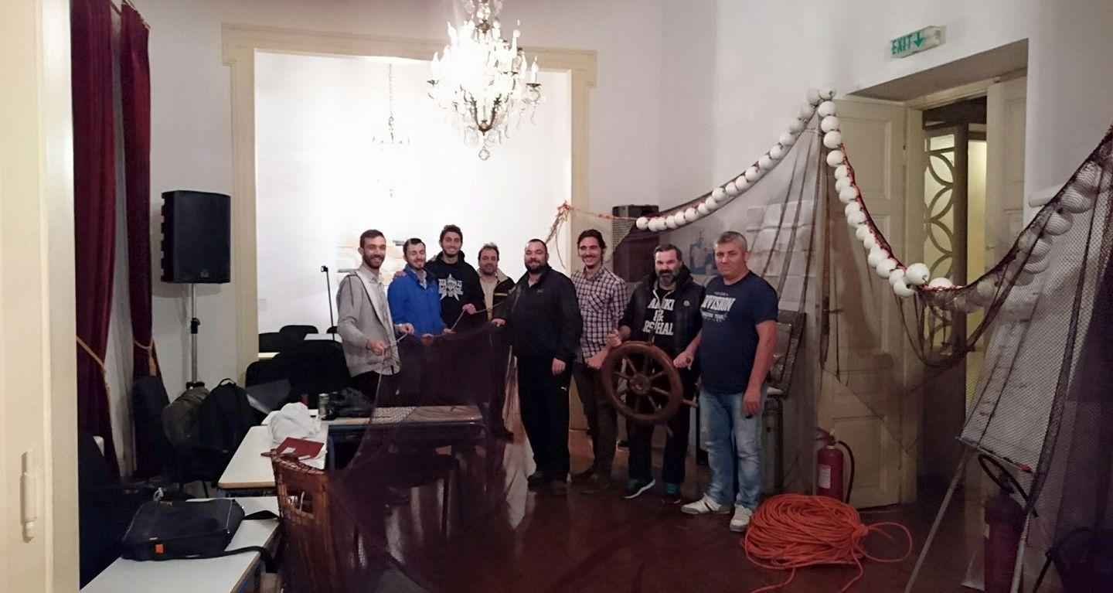
Pilot Program
8 students in Piraeus
5 students in islands e-learning
25K in revenue
100% job offers
Notes:
+milestones

Slide 9








Partners

Slide 10















Media Mentions
28 Mentions from press, Television and Radio the past 6 months

Slide 11

Education
Social
Recruitment
Commercial
Enaleia

Slide 12
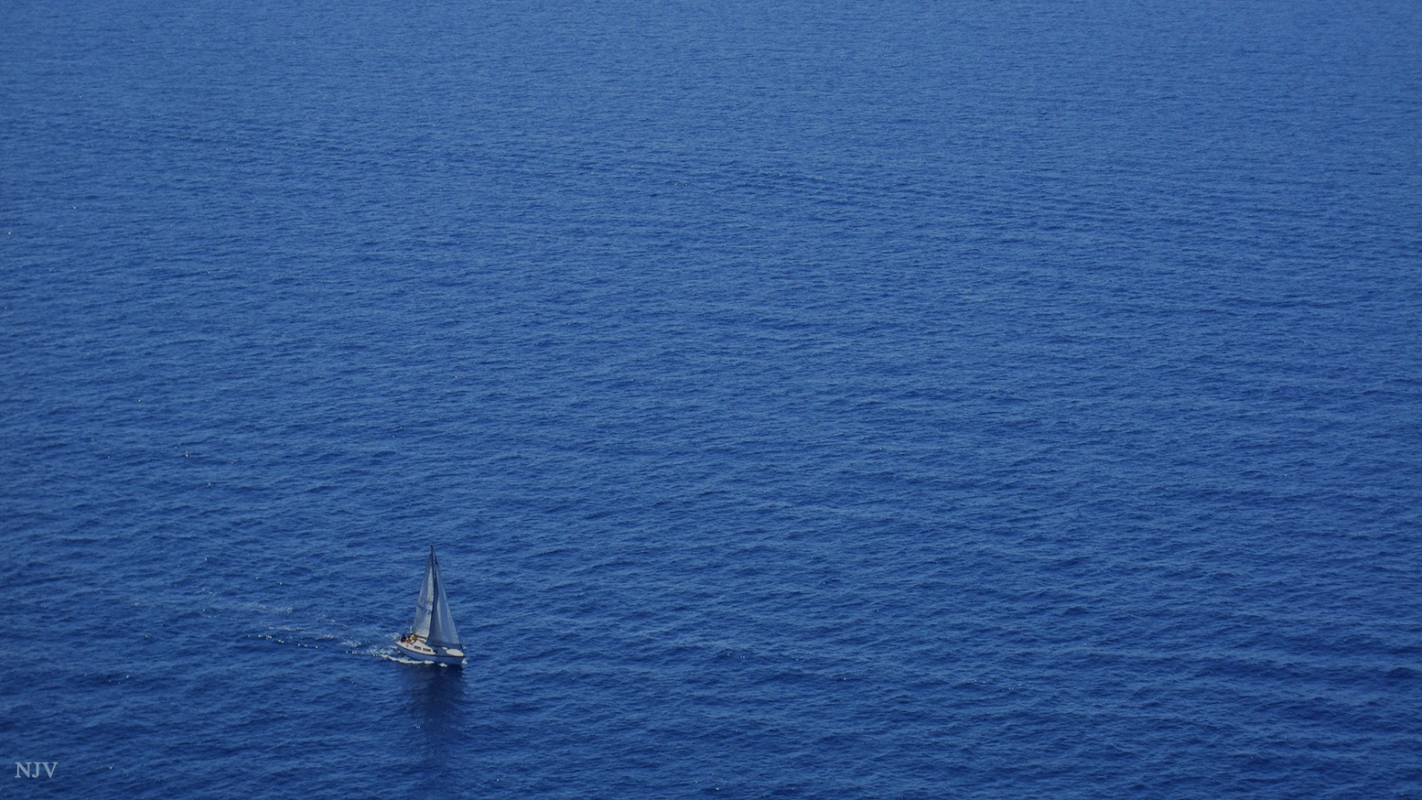

87,000 fishing ships in Europe ( Eurostat, 2016 )
Online Recruitment Platform
1 major organization-50,000 fishing ships
5,000 fishing ships in 5 years

Slide 13
10,000 people recruited
In 5 years
2,000 € average salary
20,000,000 € in revenue

Slide 14
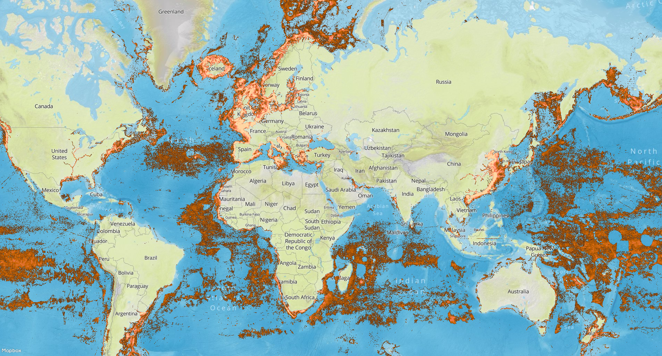

Slide 15
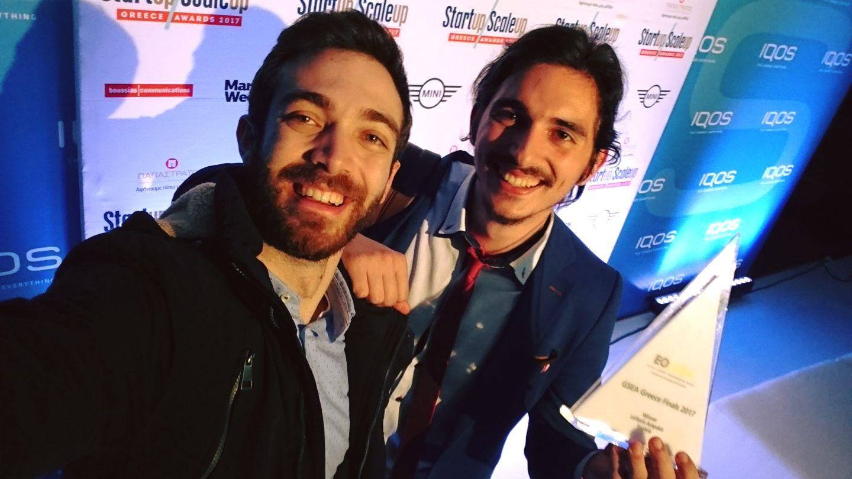
Operations and PR
Business Development and Recruitment

Slide 16

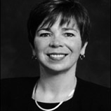
Holly Sargent
Harvard University

Slide 17
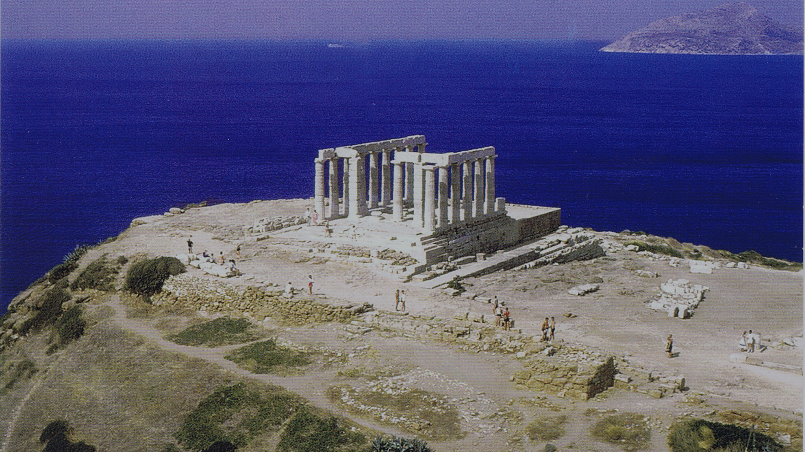
“ If Greece is completely destroyed, what will remain is an olive tree, a vine and a boat. These are enough to begin again.”
Odysseas Elitis, Greek Nobel Prized Poet

Slide 18
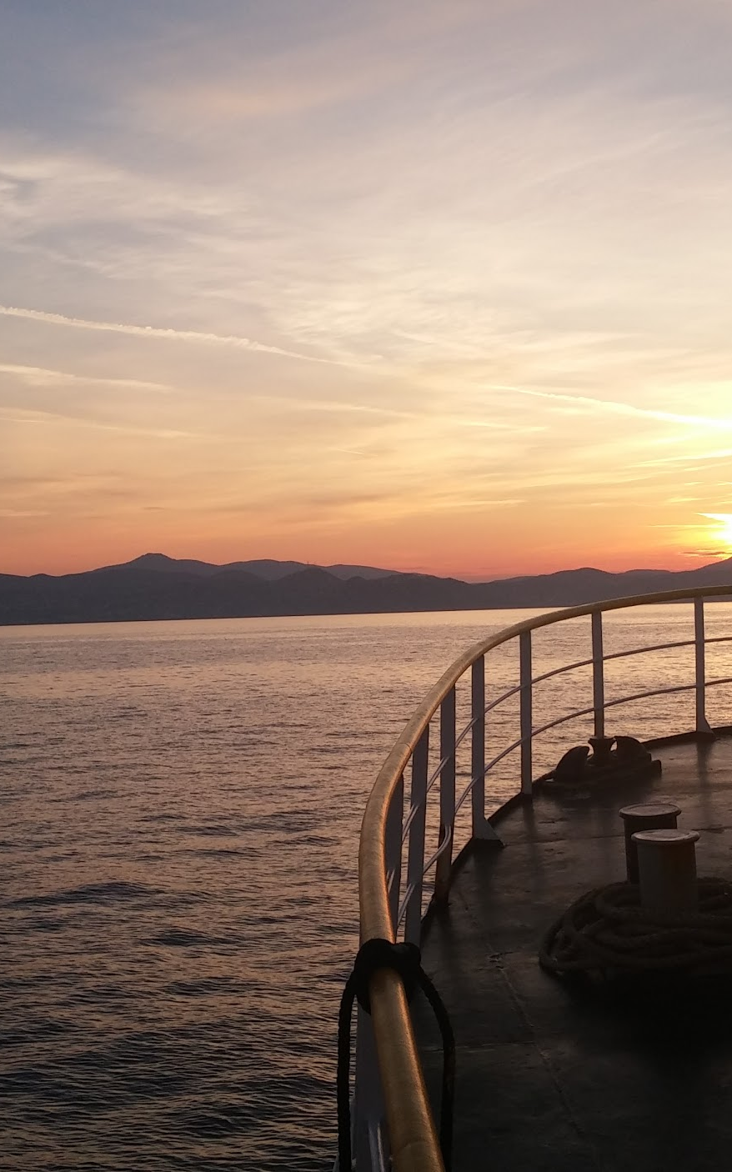
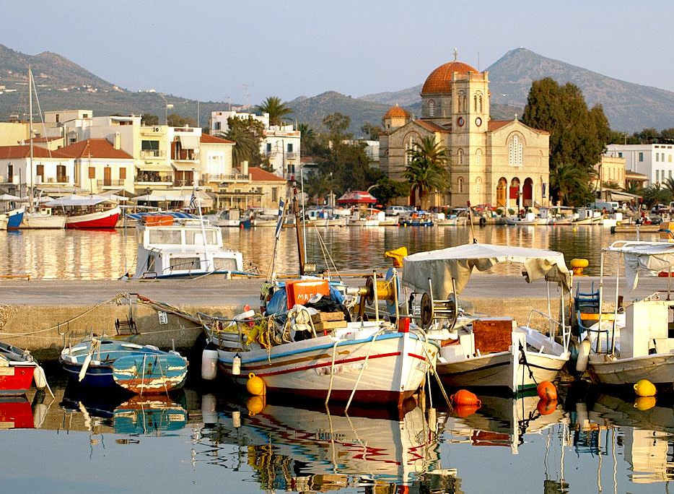
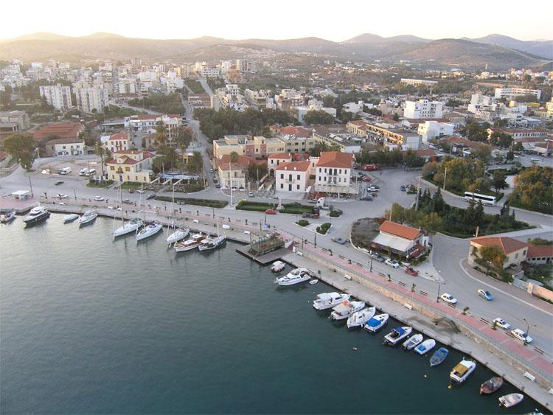
Thank you
contact: arapakis@enaleia.com

Slide 19
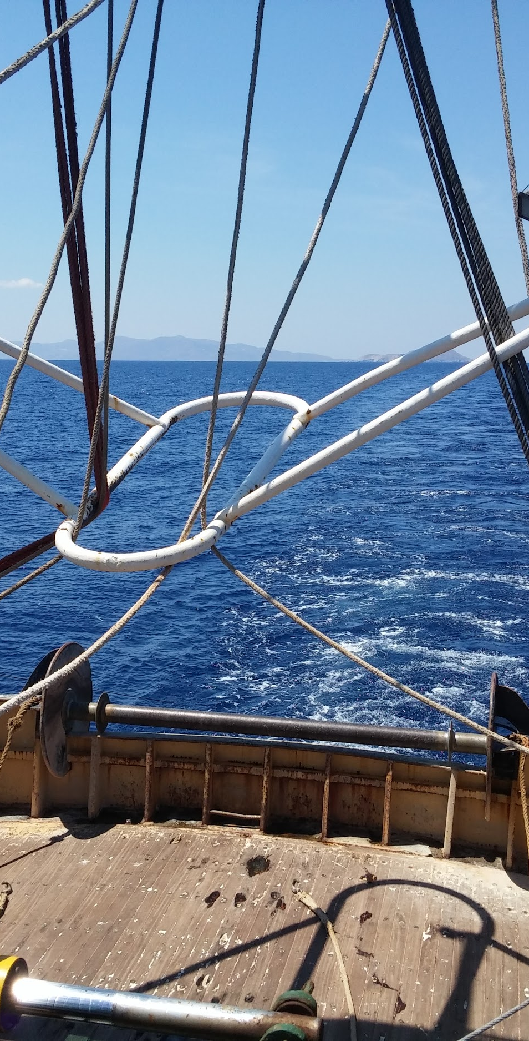
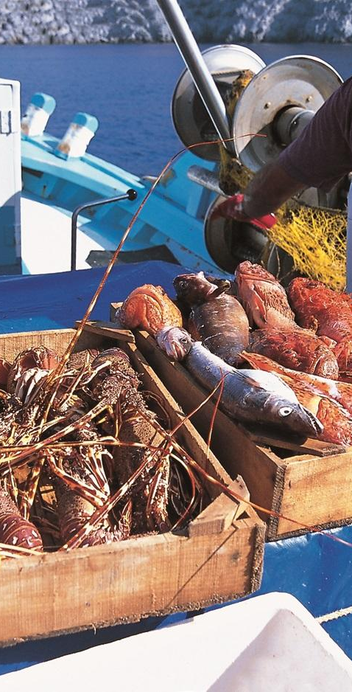
Curriculum- Practical Skills
Rescue & Safety
The craft of fishing
Fishing Tools
Fisheries-Ichthyology

Slide 20
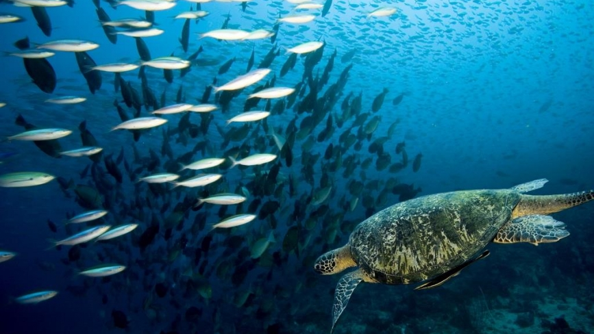
5. Communication & conflict management
6. Sustainability of the sea environment
7. Registrations & law in the fishing industry
8. New Technologies in the Fishing Sector

