Slide 1


Accessibility is not a privilege…

Slide 2
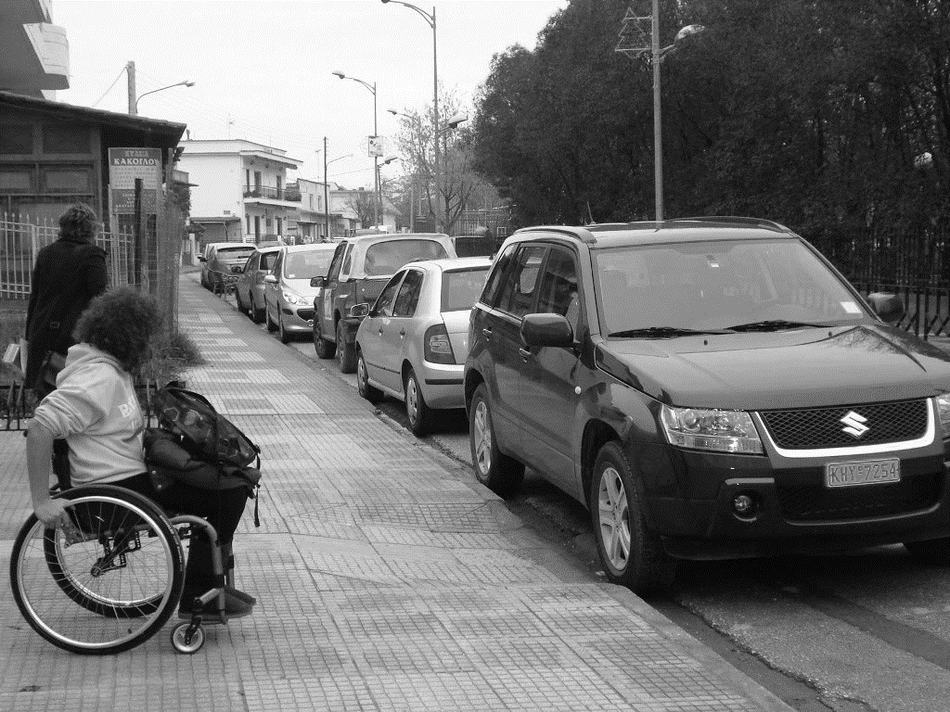
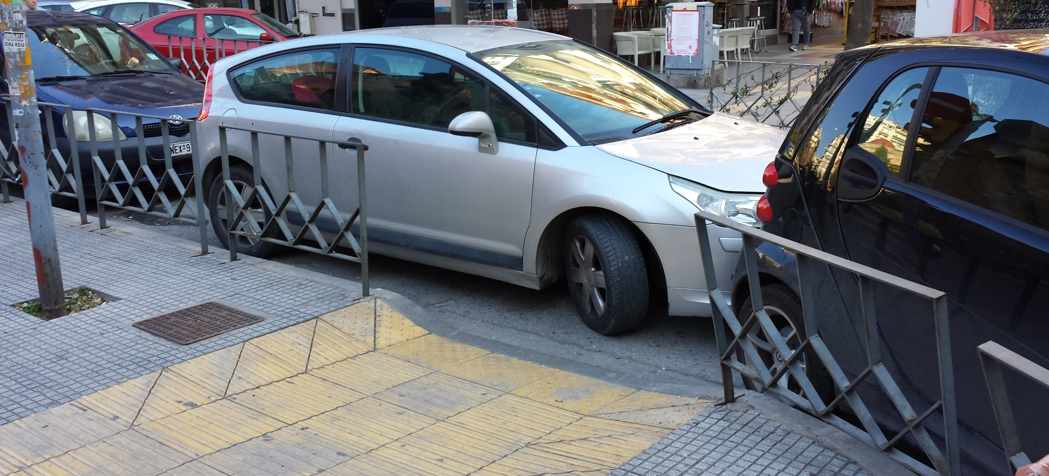
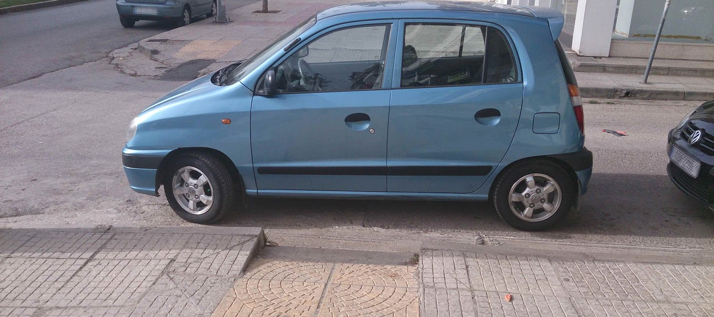
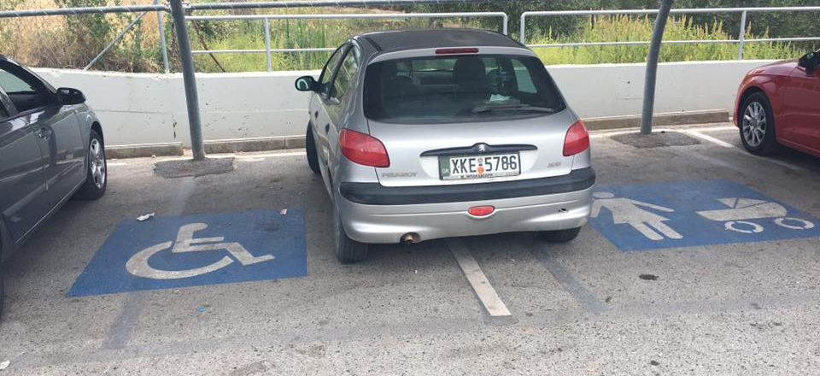

M
RE
WHY?
THAN A SIGN

Slide 3
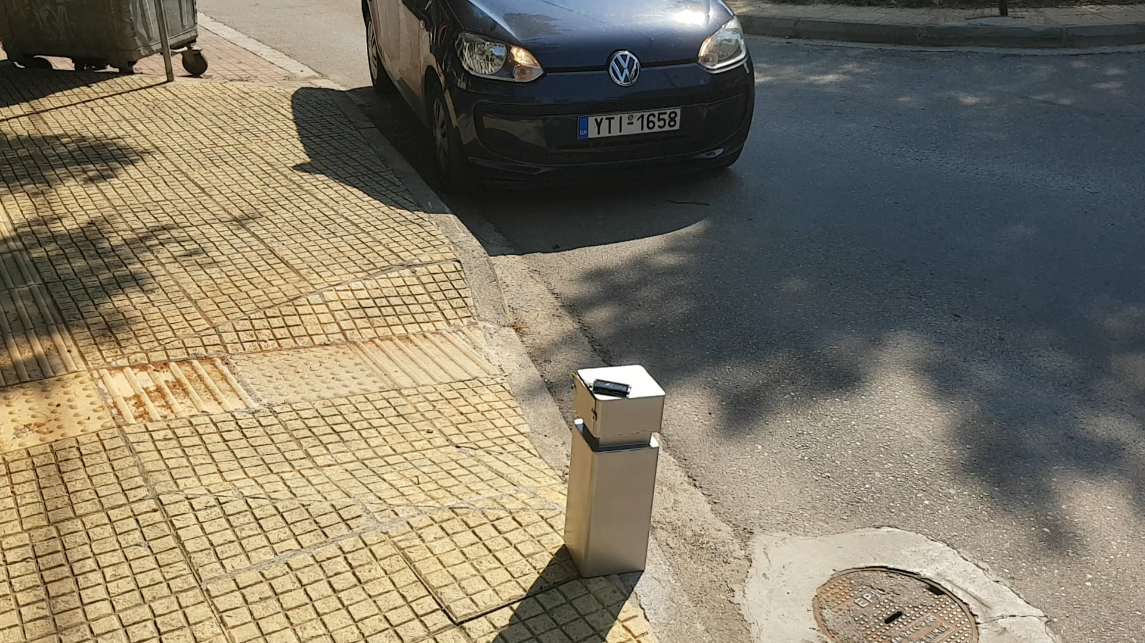
IoT CityBollard Demo

Slide 4
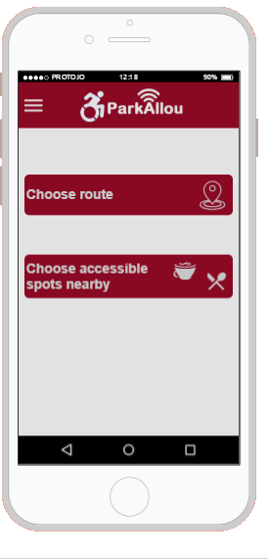
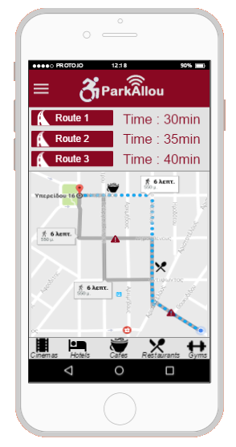
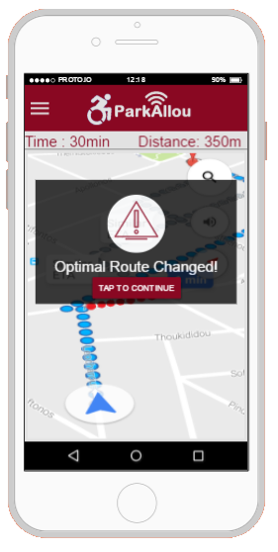
Our Application

Slide 5
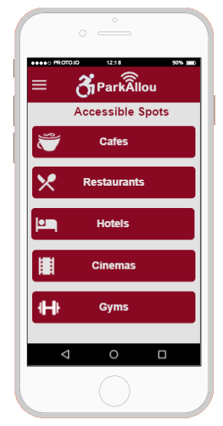
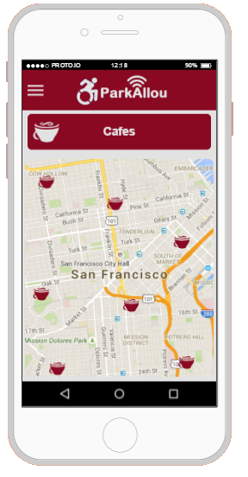
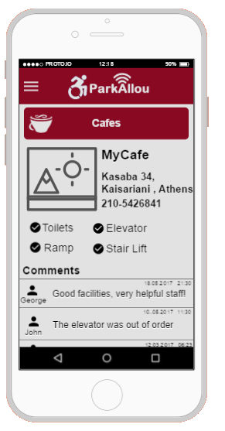



Our Application

Slide 6
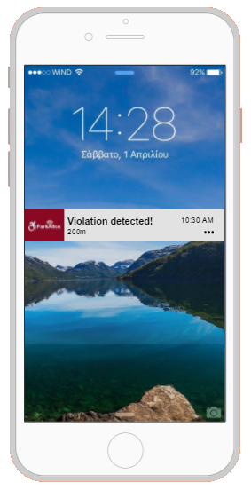
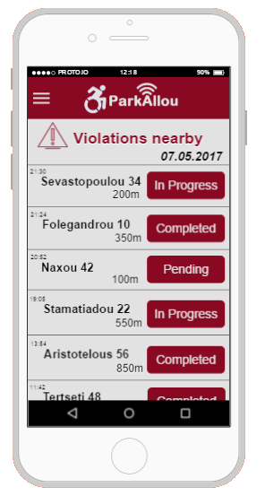
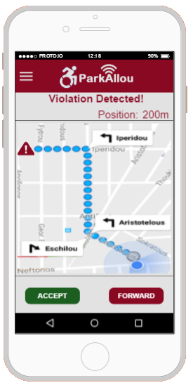

Our Application

Slide 7





Digital Innovation & Entrepreneurship
Digital Innovation & Entrepreneurship
Innovative
Idea
Internet of Things
Technology
Business Model
Financial Plan
Teamwork

Slide 8
Hybrid Manager
Management
Marketing
Computer Science
Finance
Business Strategy

Slide 9







Digital Innovation & Entrepreneurship

Slide 10





Benefits from the competition
Networking
Entrepreneurship in
other countries
Finding the most
suitable job position
Negotiate with
business partners
Implementation
of theoretical
knowledge

Slide 11



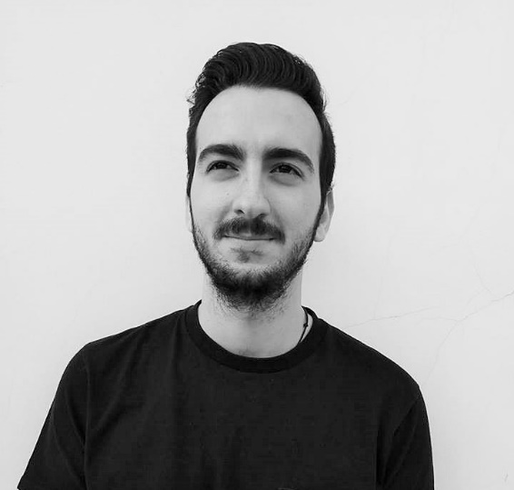
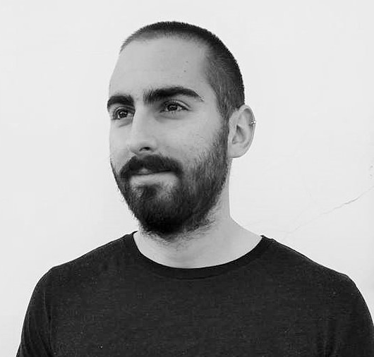
Give a chance to your ideas…
Thank you!
|
www.parkallou.com
team@parkallou.com
Tsimplakaki
Anna-Emmanouela
CEO
Georgopoulos
Panagiotis
CCO
Patrikis
Eleftherios
CTO
Pantazopoulos
Alexandros
CFO
tsimplakaki@
parkallou.com
georgopoulos@
parkallou.com
patrikis@
parkallou.com
pantazopoulos@
parkallou.com

