Slide 1



More than
100
Countries
More than
600
Universities
More than
10000
Students
More than
250
Teachers
Business Simulation Game

Slide 2
Every team consists of 4 members. Each member has a specific role:
Finance
Sales
Supply Chain
Purchasing

Slide 3

Free trip to the Netherlands!
20.000€ in cash prizes!
… But who cares about money???
Teamwork
Unique Experience
Fun!!!
Global Network

Slide 4
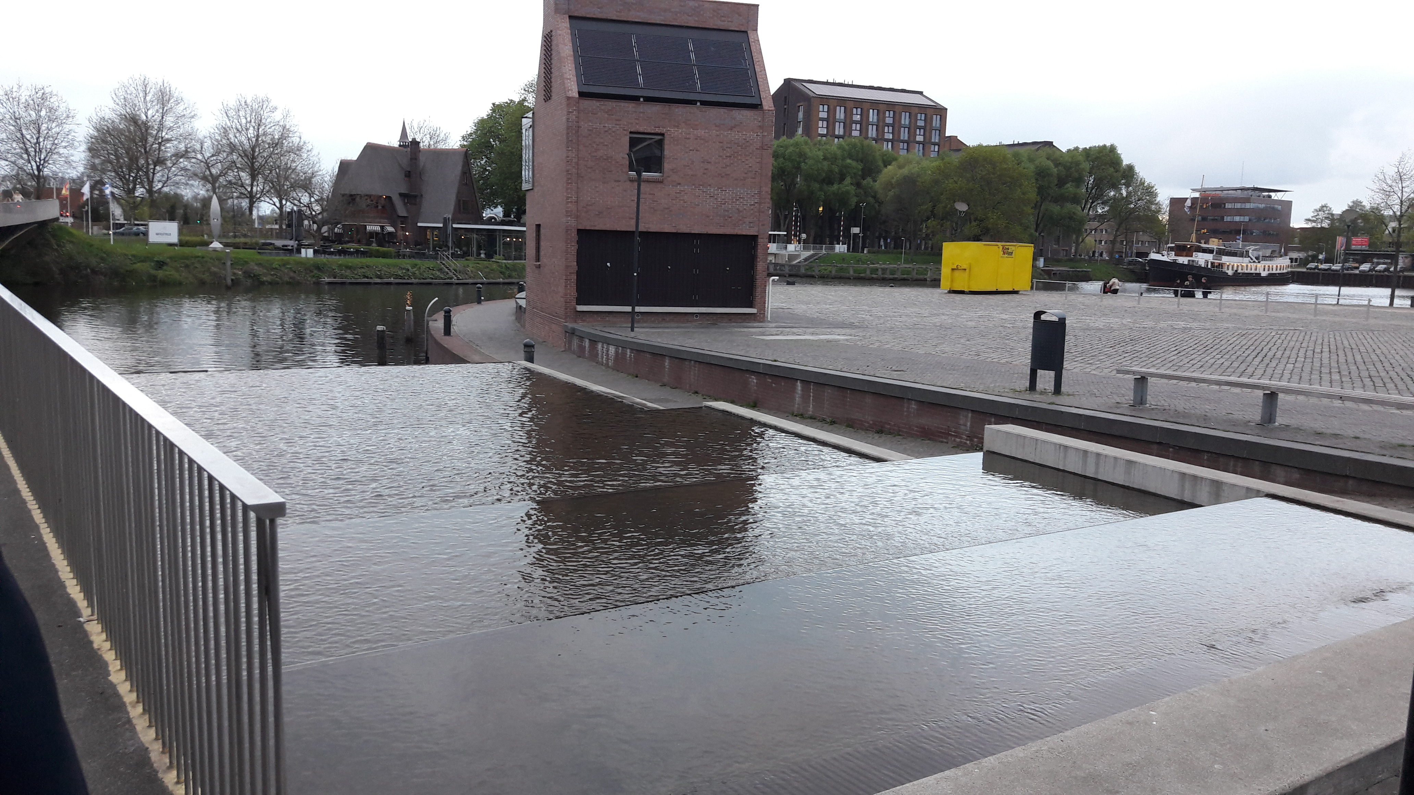
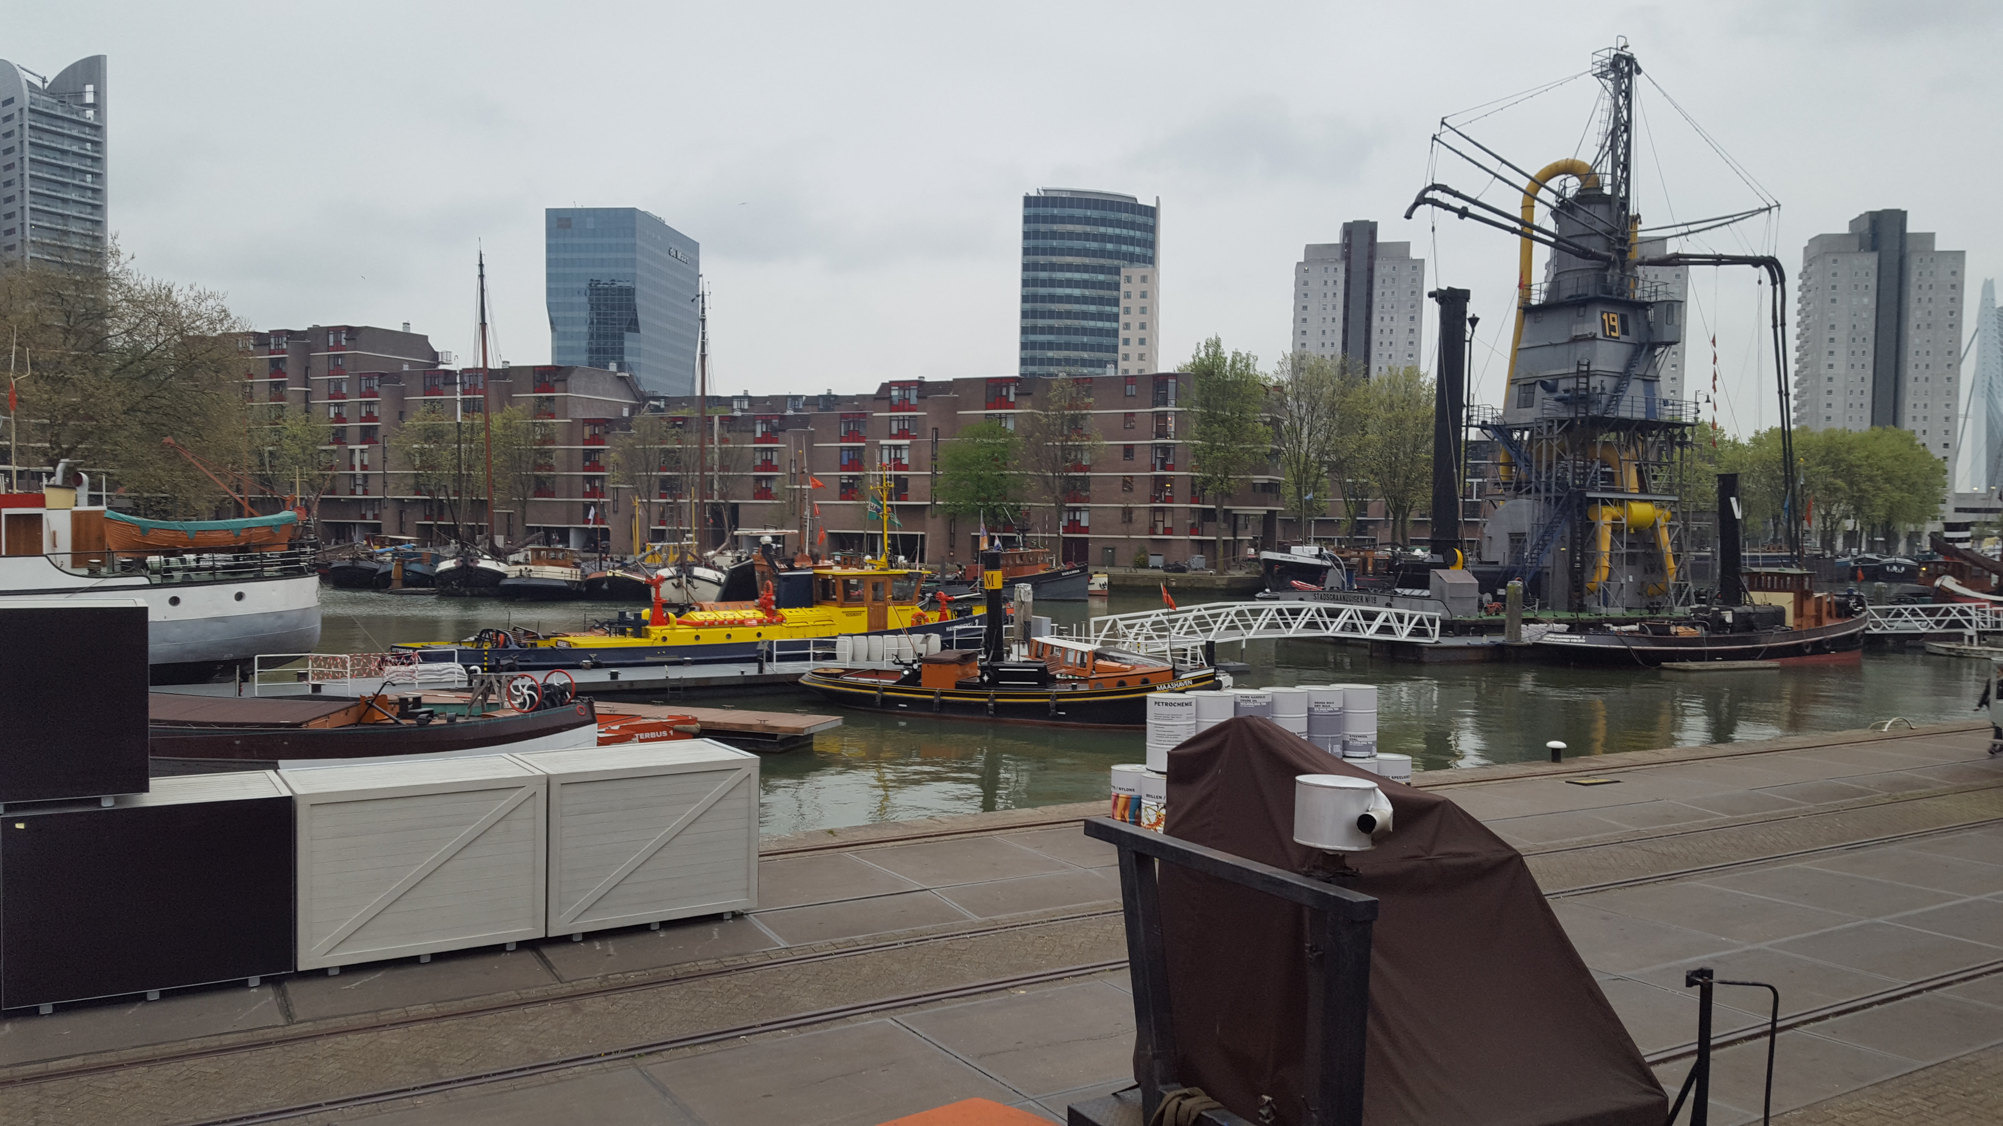
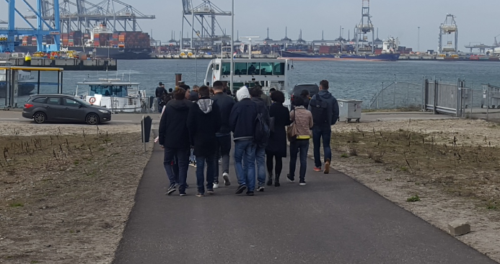
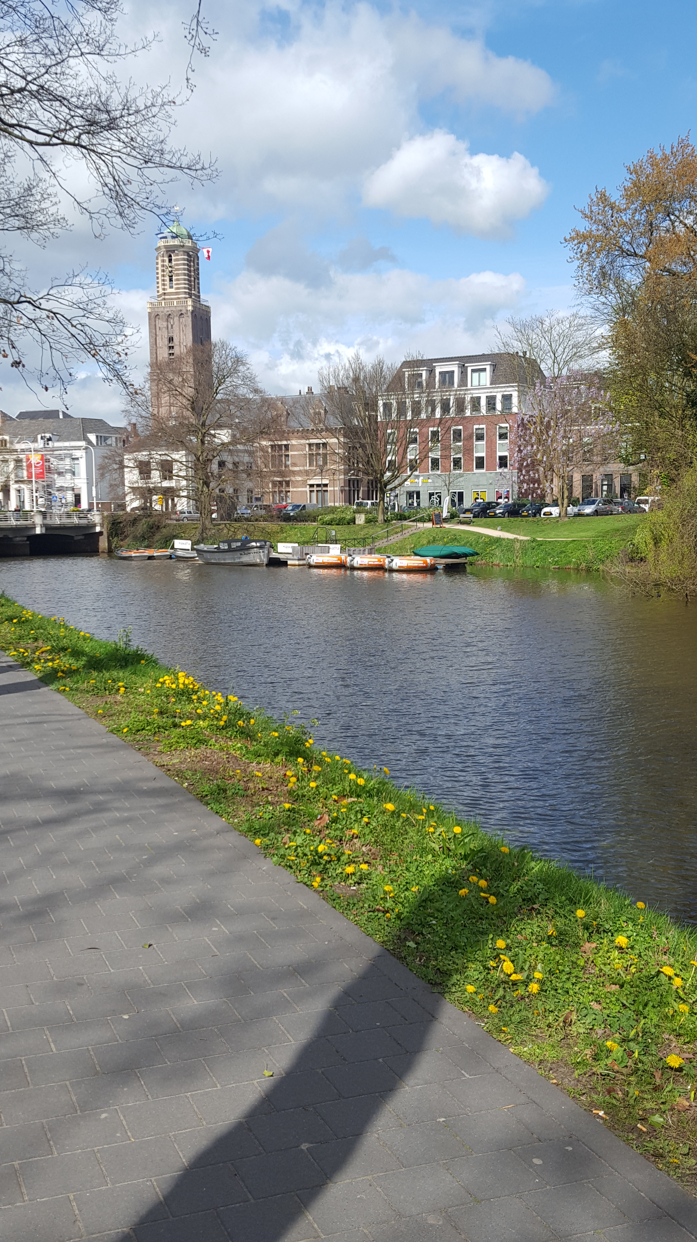
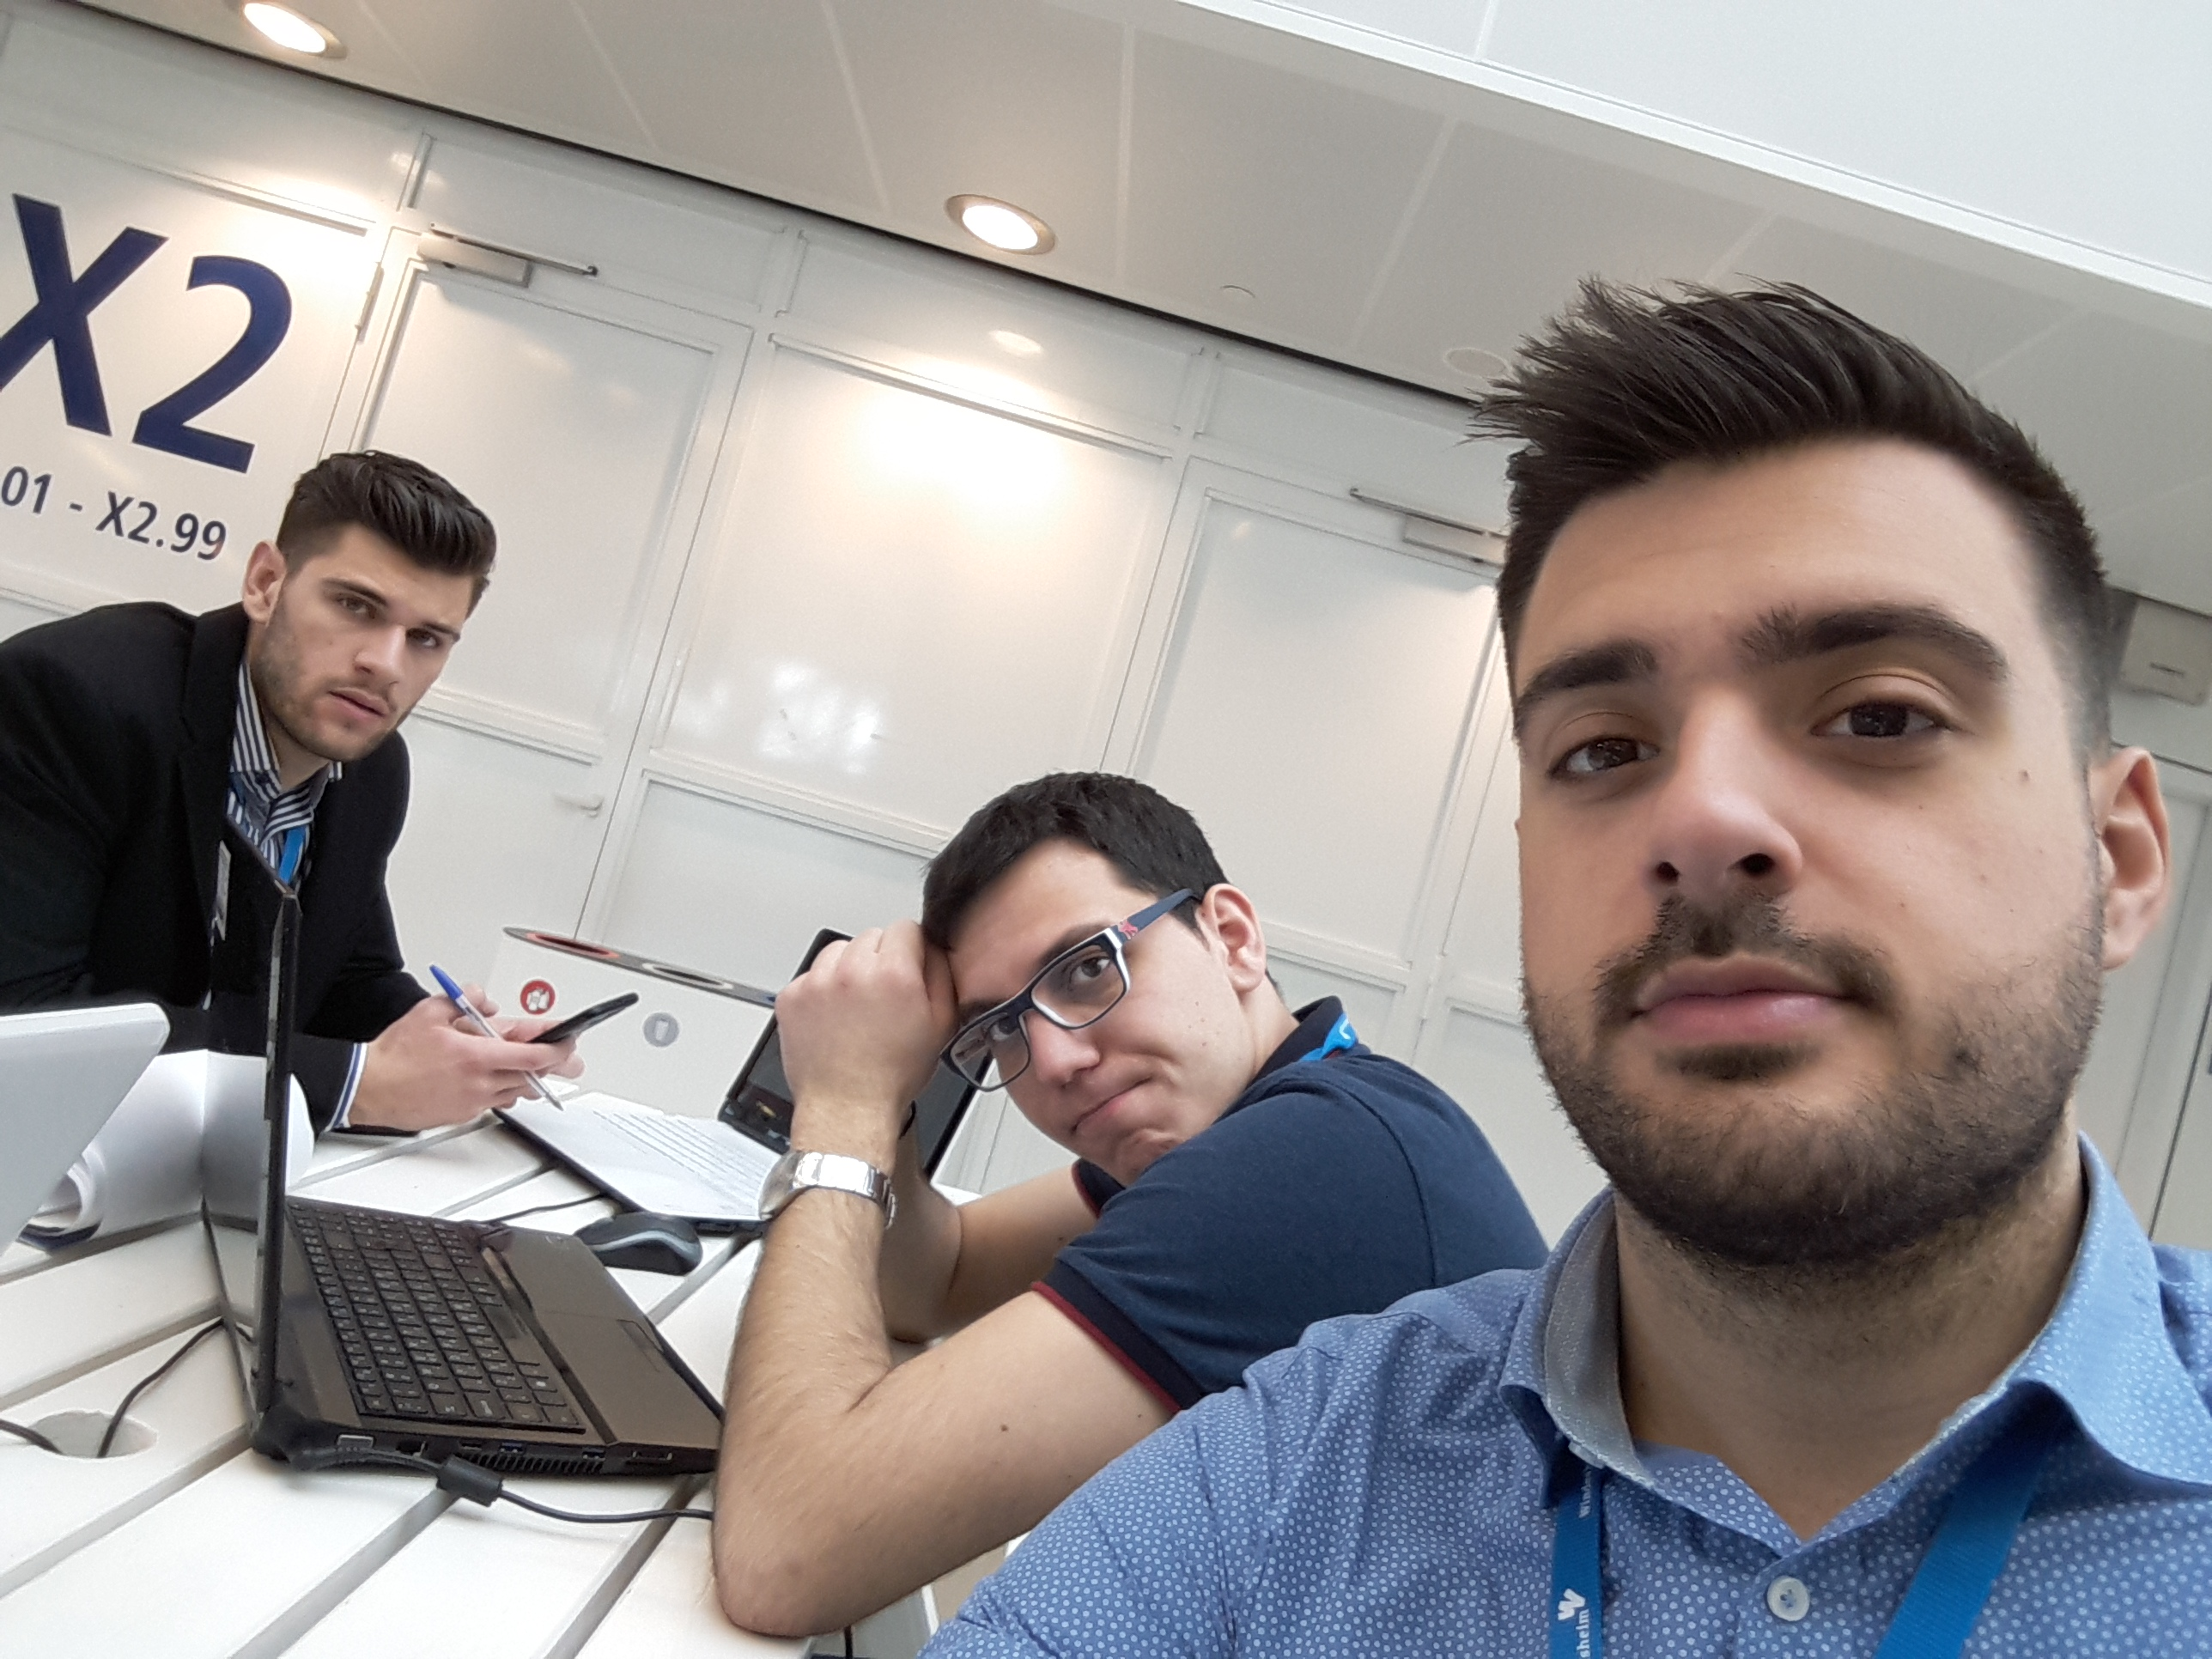
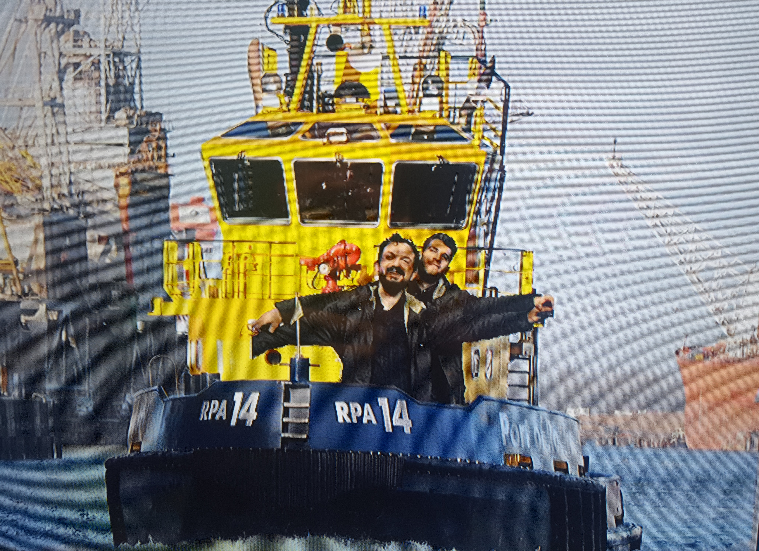
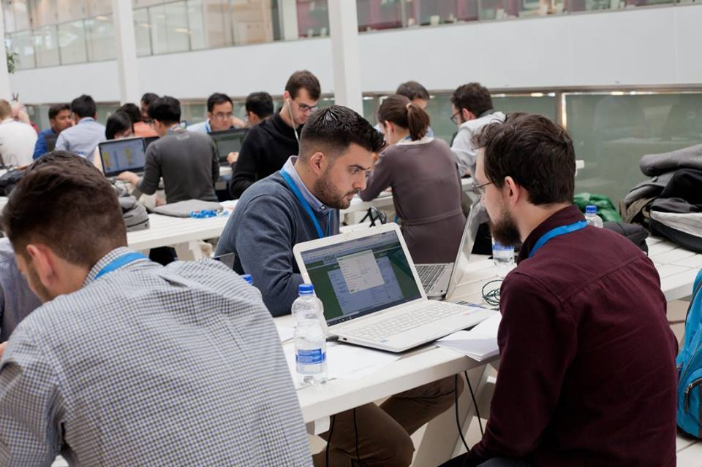
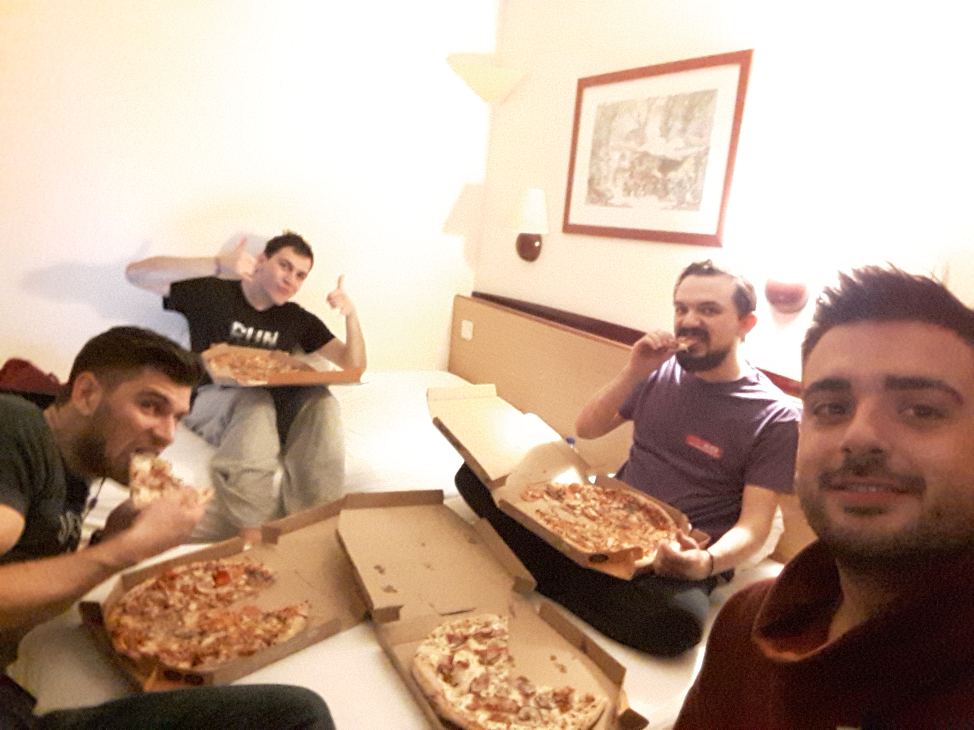
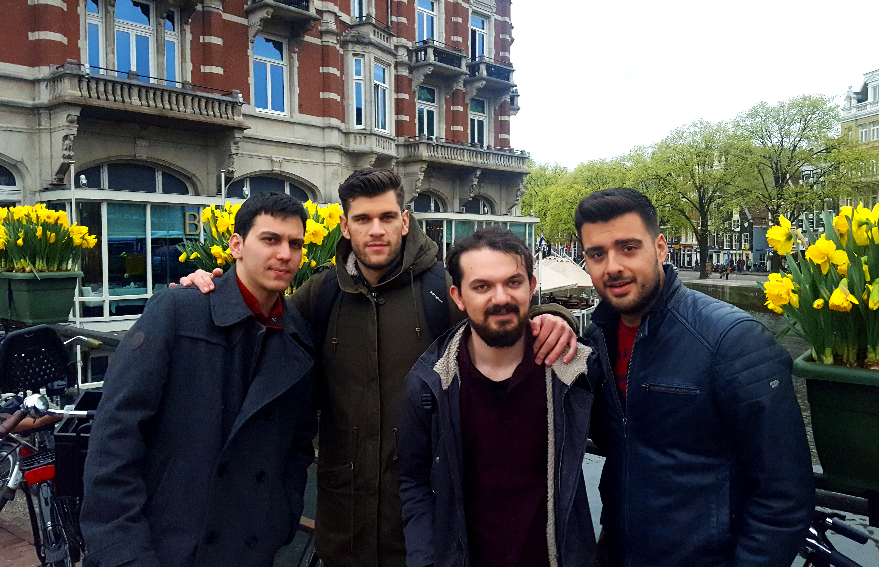
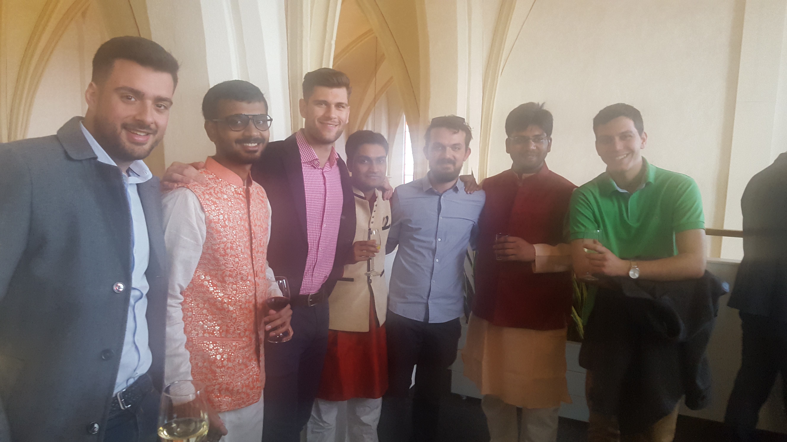

Slide 5

Hurry Up! Qualification Phase is already live!!!
https://www.globalstudentchallenge.org/
We are here to help you!
George Gravanis (geograb93@Hotmail.com)
Panagiotis Exarchakos (Panagiotis.exarchakos@gmail.com)
Manolis Chatzidavid (m.chatzidavid@gmail.com)
Dimitris Malamas (dimitrismal5595@gmail.com)

Slide 6
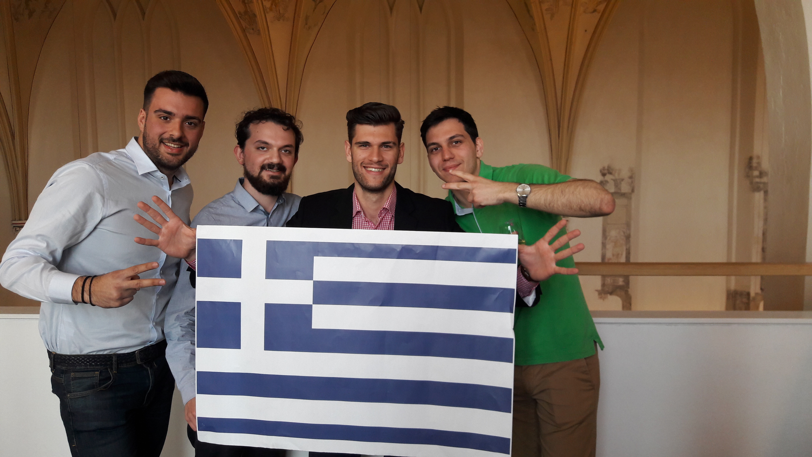
Team Chameleons welcomes you to DMST!

